Slide 1
Naïve Bayes Classifier

Slide 2
Learning
supervised
Classification with some known label
Eg: Fruit Classifier- orange, apples, bananas
unsupervised
Seen lots of example but not a proper label.
Like clustering
Eg: Fruit Classifier- “fruit with soft skin”. “red fruits”

Slide 3
Supervised learning
Naïve Bayes
Decision tree
SVM
Linear regression
Classification
Regression
Polynomial regression
SVM Regression
O/P variable is real or continuous values like marks or weight
Draw conclusions like spam or not, red or blue

Slide 4
What Is Naive Bayes?
Naive Bayes is among one of the simplest, but most powerful algorithms for classification based on Bayes' Theorem with an assumption of independence among predictors.
The Naive Bayes model is easy to build and particularly useful for very large data sets. There are two parts to this algorithm:
Naive
Bayes
The Naive Bayes classifier assumes that the presence of a feature in a class is unrelated to any other feature.
Even if these features depend on each other or upon the existence of the other features, all of these properties independently contribute to the probability that a particular fruit is an apple or an orange or a banana, and that is why it is known as "Naive."

Slide 5
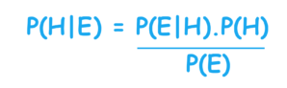
What Is Bayes' Theorem?
In statistics and probability theory, Bayes' theorem describes the probability of an event, based on prior knowledge of conditions that might be related to the event. It serves as a way to figure out conditional probability.
Given a Hypothesis (H) and evidence (E), Bayes' Theorem states that the relationship between the probability of the hypothesis before getting the evidence, P(H), and the probability of the hypothesis after getting the evidence, P(H|E), is :
For this reason, P(H) is called the prior probability, while P(H|E) is called the posterior probability. The factor that relates the two, P(E|H)/P(E), is called the likelihood ratio. Using these terms, Bayes' theorem can be rephrased as:
"The posterior probability equals the prior probability times the likelihood ratio."

Slide 6
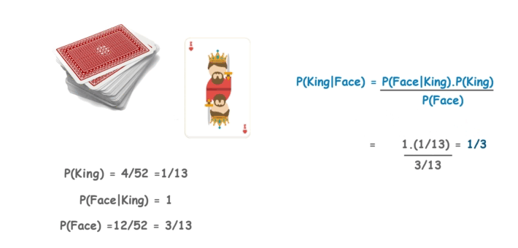
Bayes' Theorem Example
Let's suppose we have a Deck of Cards and we wish to find out the probability of the card we picked at random to being a king, given that it is a face card. So, according to Bayes' Theorem, we can solve this problem. First, we need to find out the probability:
P(King) which is 4/52 as there are 4 Kings in a Deck of Cards.
P(Face|King) is equal to 1 as all the Kings are face Cards.
P(Face) is equal to 12/52 as there are 3 Face Cards in a Suit of 13 cards and there are 4 Suits in total.

Slide 7

Game Prediction Using Bayes' Theorem
NAÏVE BAYS EXAMPLE:
To predict days suitable for a football match based on weather conditions

Slide 8
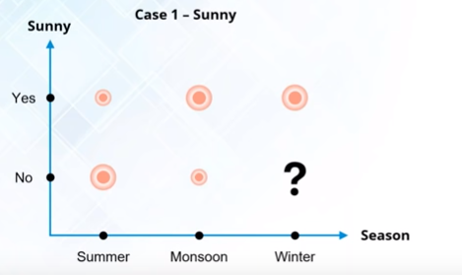
Smaller circle- low probability to play (P<0.5)
Big Circle- High probability to play (P>0.5

Slide 9
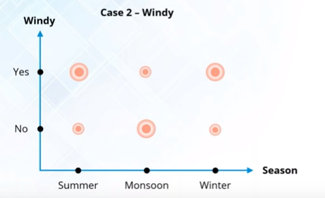

Slide 10
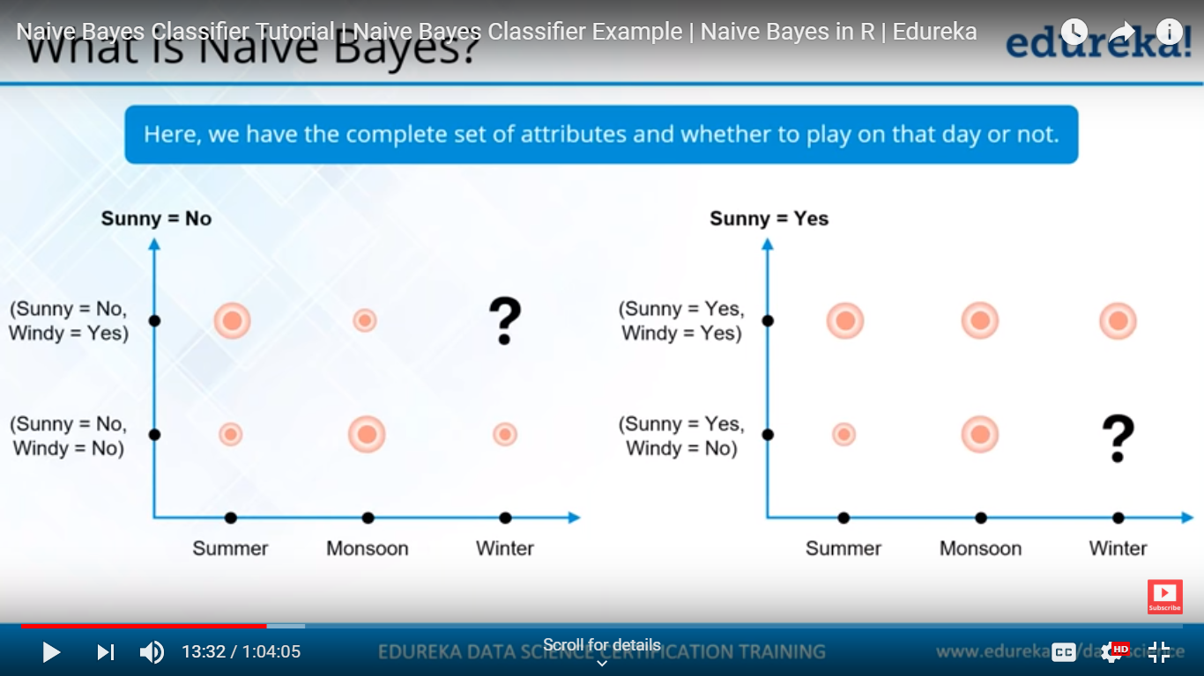
Combining both the conditions
We get an outlook by combining both the data

Slide 11
Comparing the states when more information is added
Naïve bayes tries to understand such interaction of probability

Slide 12
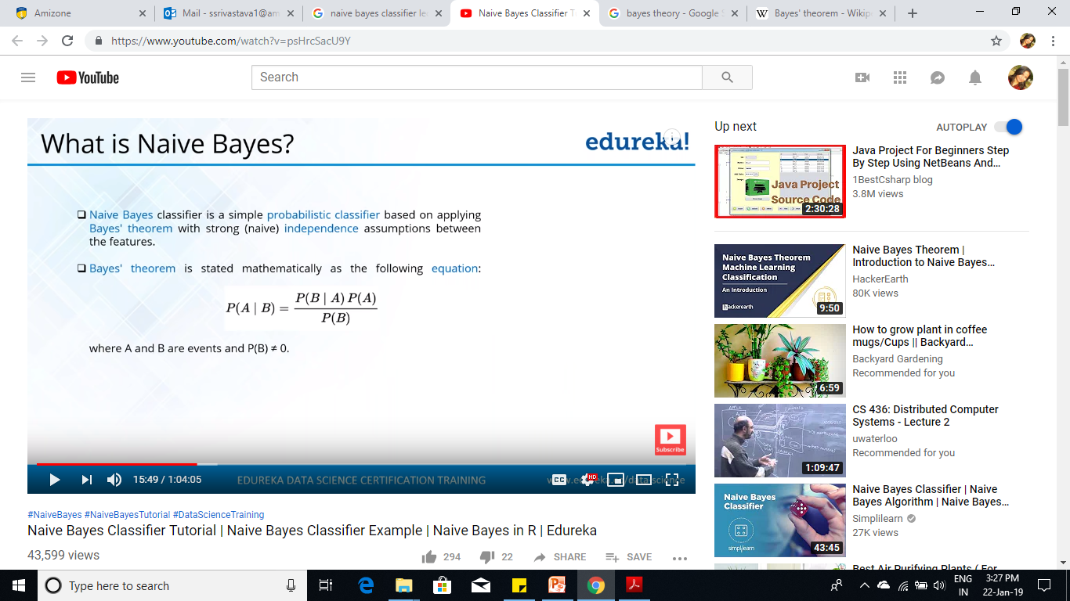
Probabilistic classifier based on Bayes’ Theorem
Naïve Bayes Classifier
Takes independent assumptions between the features.

Slide 13
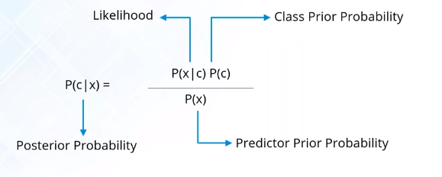

Slide 14
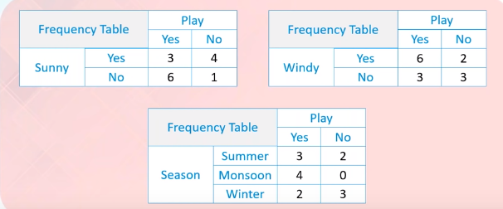
Related dataset

Slide 15
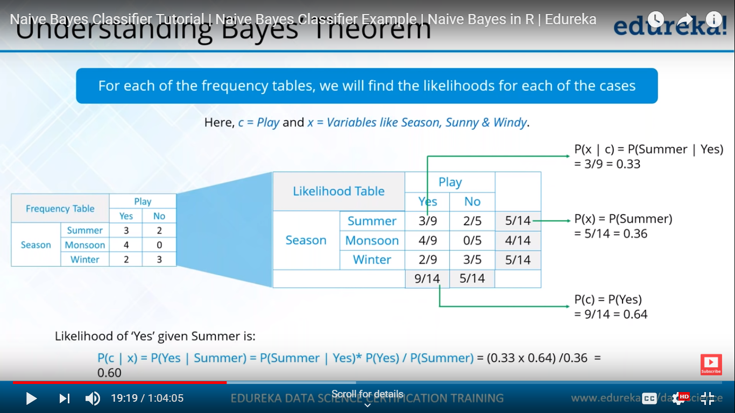

Attribute probability
Probability of the class
0.60
Prior Probability

Slide 16

Predict the likelihood to play football on ( Season =Winter, Sunny=No, Windy= yes

Slide 18
Probability of match not being played??

Slide 19
Face recognition
Mail classification
Handwriting analysis
Salary prediction

